Slide 1
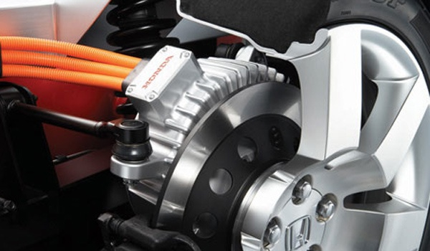
The Motor Principle
This lesson will introduce you to the concepts associated with electric motors
You will also learn about the magnetic fields and how to determine the direction of rotation of an electric motor

Slide 2
Learning Goals
By the end of this lesson, you will be able to:
explain magnetic forces
use the RHR to solve for the direction of magnetic force
determine the direction of rotation of a motor
solve problems involving magnetic forces

Slide 3
Success Criteria
Can I:
explain magnetic forces
use the RHR to solve for the direction of magnetic force
determine the direction of rotation of a motor
solve problems involving magnetic forces

Slide 4
The motor Principle
Two magnetic fields interact with one another to produce a force.
If the conductor that carries a current cuts through an
external magnetic field, it experiences a force perpendicular to both the conductor’s current flow and the external magnetic field.
The strength of this force depends on the strength of the external magnetic field and the current through the conductor.

Slide 5
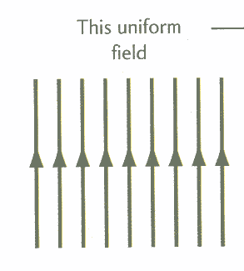
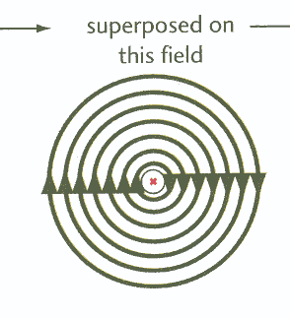
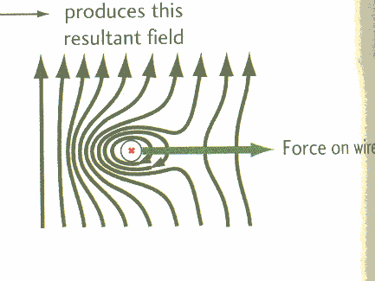
RHR #3: Open the right hand so that the fingers point in the dir of the external magnetic field. Rotate the hand so that the thumb points in the dir of the
current flow. The force is in the dir in which the palm faces.

Slide 6
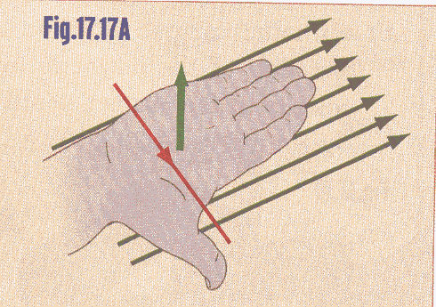
A convention that we use to represent the dir of current
into or out of page is as follows: • = out x = in

Slide 7
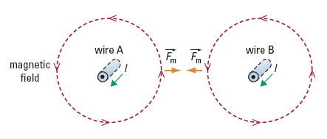

Slide 8
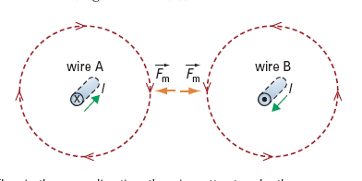

Slide 9
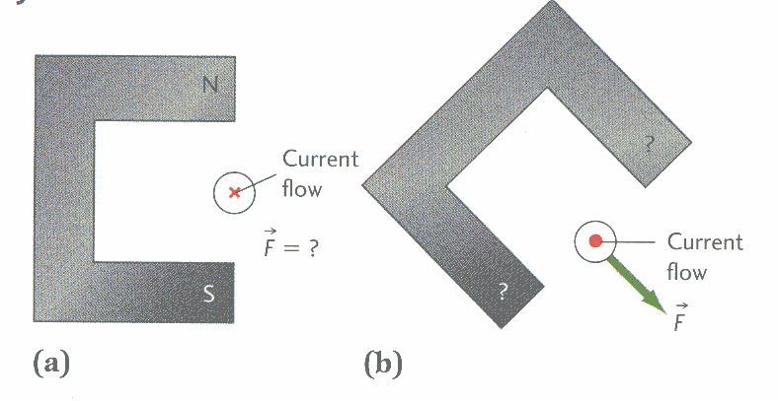
Application of the motor Principle
Determine the unknown quantity in each of the
following examples

Slide 10
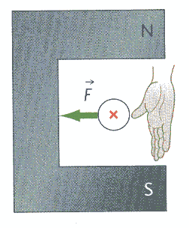
Sol’n:
We use the RHR to determine the unknown
quantities.

Slide 11
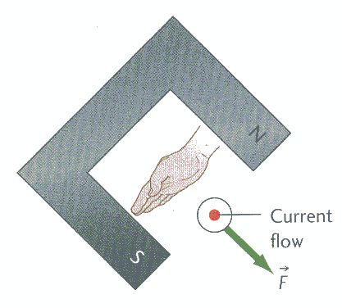

Slide 12
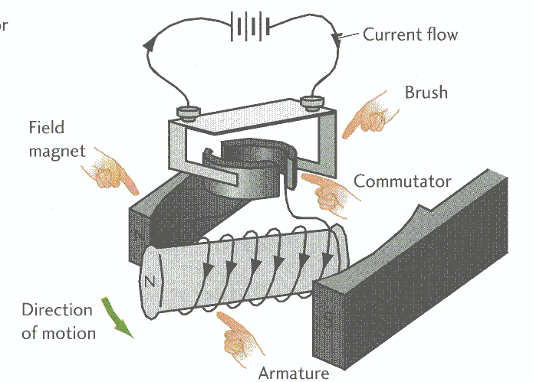
The Electric Motor

Slide 13
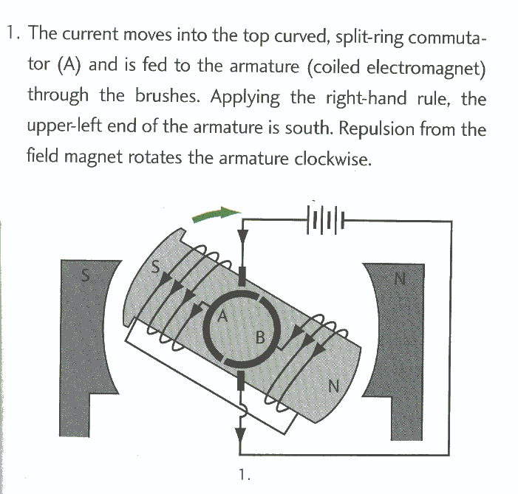

Slide 14
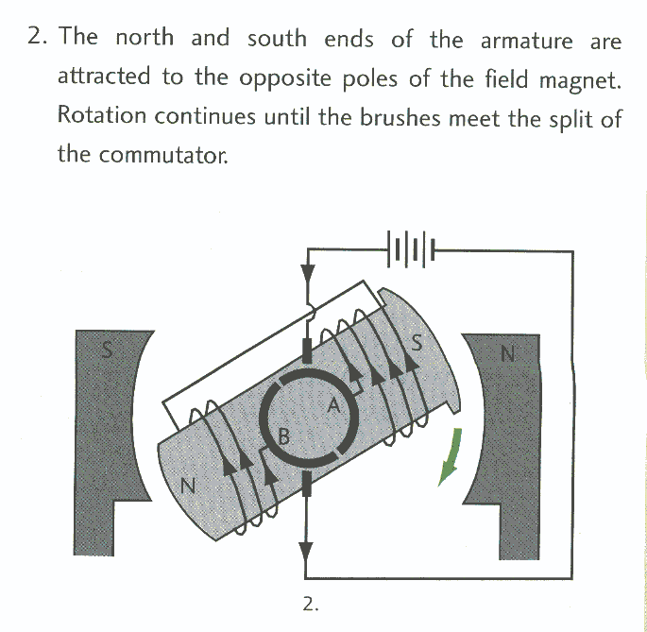

Slide 15
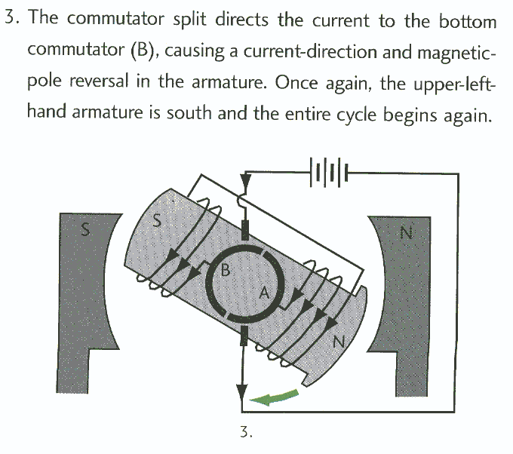

Slide 16
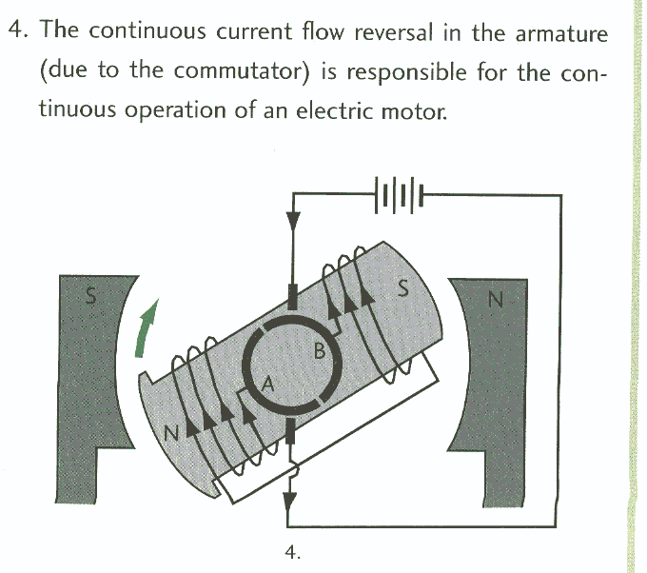

Slide 17
HOMEWORK
Read Section 12.5 and 12.6
Review Tutorials in the sections
Questions 1 – 6 pg 566
1 – 3 pg 571

